Slide 1

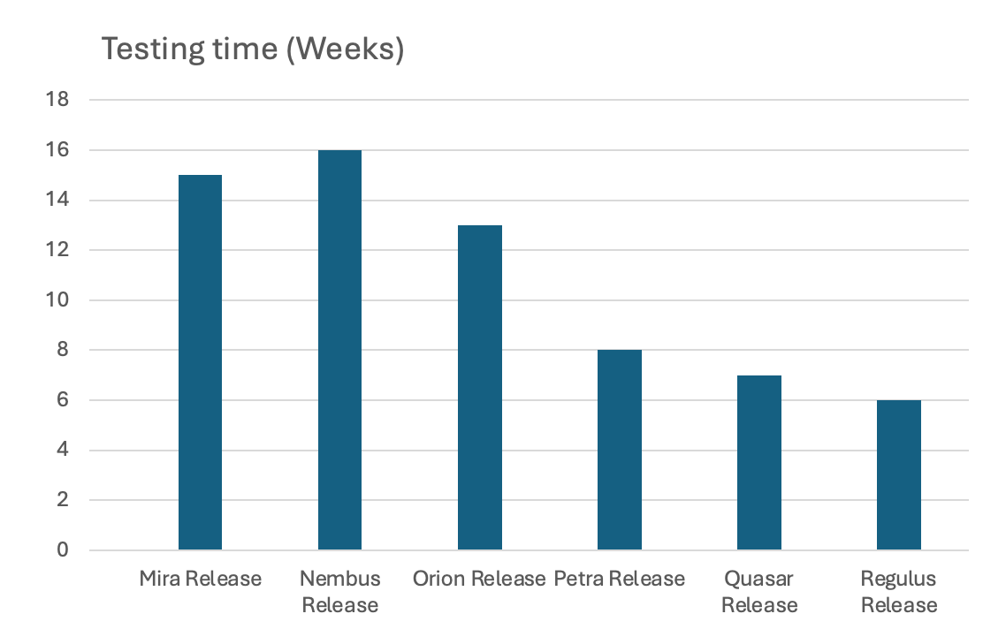
Modernising Quality Assurance for Clinical Grade Rare Disease Pipelines
Luke Paul Buttigieg¹, Conor Proud¹, Nadine Feliz¹, Gabriel Aldam¹, Ricardo Humberto Ramirez Gonzalez¹,
Vivek Khandelwal¹, Barbara Kalinowskamajka², Catherine Whibley¹, Javier Lopez¹, Rare Disease Pipelines Squad*
Background
Genomics England is a national organisation delivering large‑scale whole‑genome sequencing and analytical infrastructure for the NHS Genomics Medicine Service (GMS), enabling high‑quality genomic healthcare and research across the UK. Within this system, the rare disease (RD) pipeline is the core variant‑calling and prioritisation workflow underpinning RD genome analysis.
Historically, validation and verification (V&V) of each RD pipeline release depended on executing full‑sized samples that represented key clinical scenarios. While comprehensive, this approach was slow and costly: full run failures required complete reruns, and the process exercised many interconnected components of the broader GMS ecosystem, rather than isolating the pipeline itself. Limited earlier‑stage testing (e.g., unit or integration tests) meant defects often surfaced only at the final—and most expensive—stage of end‑to‑end runs.
In parallel, the workflow codebase lacked modularity and clear interfaces. Individual modules frequently combined multiple responsibilities, making targeted or granular testing difficult and sometimes impossible. Collectively, these factors led to slow feedback cycles, reduced developer agility, and overreliance on heavyweight V&V processes.
Methods and Results
Over the past two years, we have introduced a layered testing strategy to accelerate feedback and enable faster releases of new versions of the rare disease (RD) pipeline. Guided by the Testing Trophy model (Kent C. Dodds), we shifted our focus toward faster, earlier, and more targeted methods of validation—reducing reliance on slow, full‑sized regression runs and enabling continuous assurance of pipeline quality.
1. Testing Trophy–Led Shift‑Left: Converting Full‑Sized Tests into Fast Integration Tests Using the Testing Trophy (Kent C. Dodds) model, we rebalanced our testing strategy toward integration and unit tests. By analysing what full‑sized samples were actually validating, we converted these into fast integration tests that check the same behaviours in seconds instead of hours. This cut routine full‑sized regression runs by over 50% and enabled continuous integration tests to block defects before they are merged.
2. Automated Expected‑Outcome Validation Expected outputs from legacy full‑sized runs were stored in a version‑controlled repository as opposed to a shared document, enabling automated comparison of expected vs. actual results and eliminating slow, manual validation steps. This makes it easier to test more frequently and consolidates all sources of truth into one for use by automation and for human consumption.
3. Creation of “Tiny Genomes” for Rapid but Representative Testing We created minimal but representative datasets (tiny whole genome sequencing samples) that exercise all key workflow paths while drastically reducing data volume by only minimally covering genome base locations. These run around 75% faster while still providing strong assurance of correct pipeline integration, going from over 4 hours to just over 1 hour. This resource can be shared with the wider bioinformatics community, on request.
4. Nightly Tiny‑Genome Testing for Early Regression Detection Nightly tiny‑genome runs on both release and latest builds now provide daily feedback on pipeline robustness. This allows early detection of regressions without waiting for the full‑sized test pack, leaving only nuanced issues for higher‑level validation like full sized regression test runs. It also tests integration of the RD pipeline with complimentary APIs.
5. Targeted Module‑Level Testing with a Nextflow‑Based Workflow A new Nextflow‑based test workflow allows isolated execution of specific RD pipeline logic—such as variant prioritisation—supporting AB testing of different versions, rapid debugging, performance optimisations, parameter scanning, and faster iteration. This tool is showcased in a dedicated poster at Festival of Genomics 2026 by FX Quah.
6. Workflow Refactoring to Improve Testability and Modularity We are refactoring the workflow codebase so modules do one thing well, avoid external calls mid‑execution, define clear interfaces, and remove unnecessary inter‑module dependencies. This modularisation dramatically improves testability and reduces the need for full workflow runs to validate small components.
Figure 1: Testing time in weeks per release
We can observe a decreasing number of weeks taken to test each release, which is
partly attributed to the introduction of the various testing improvements described here.
Total testing time per release has decreased by over 60% in part following the introduction of these measures, following the Nembus release.
Conclusion
Together, these innovations have transformed how we validate and maintain the rare disease pipeline—shifting testing earlier, reducing reliance on slow full‑sized workflows, and enabling rapid, continuous feedback throughout development. By introducing faster and more targeted testing methods, improving automation, and refactoring the workflow for modularity and clarity, we have significantly strengthened reliability while contributing to accelerating delivery by over 60% (Figure 1). This modernised approach not only improves developer efficiency and system robustness but also lays the foundation for sustainable, scalable pipeline development that can support the growing needs of the Genomics Medicine Service.
1: Genomics England Ltd.
2: Ardigen Ltd.
*: Rare Disease Pipelines Squad members: FX Quah, Kevin Savage, Liam Abrahams, Mark Doherty, Yanisa Sunthornyotin, Pawel Ciurka (Ardigen Ltd.),
Paresh Viradiya, Sat Dhamu, Jamie Ellingford, Dalia Kasperaviciute
luke-paul.buttigieg@genomicsengland.co.uk

